Slide 1
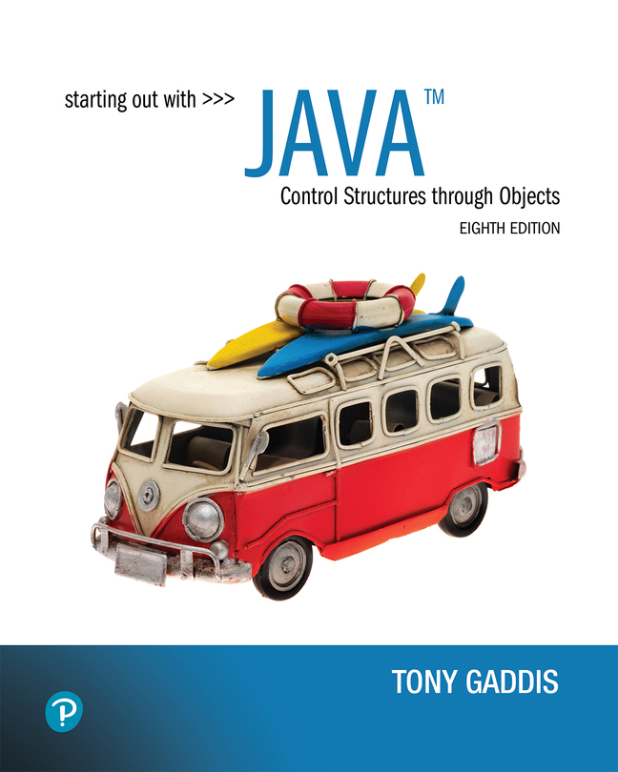

Starting Out with Java Control Structures Through Objects
Eighth Edition
Chapter 8
A Second Look At Classes and Objects
Copyright © 2022 Pearson Education, Inc. All Rights Reserved
Notes:
If this PowerPoint presentation contains mathematical equations, you may need to check that your computer has the following installed:
1) MathType Plugin
2) Math Player (free versions available)
3) NVDA Reader (free versions available)

Slide 2
Chapter Topics (1 of 2)
Chapter 8 discusses the following main topics:
Static Class Members
Passing Objects as Arguments to Methods
Returning Objects from Methods
The toString method
Writing an equals Method
Methods that Copy Objects

Slide 3
Chapter Topics (2 of 2)
Chapter 8 discusses the following main topics:
Aggregation
The this Reference Variable
Mutable and Immutable Classes
Enumerated Types
Garbage Collection
Focus on Object-Oriented Design: Class Collaboration

Slide 4
Review of Instance Fields and Methods
Each instance of a class has its own copy of instance variables.
Example:
The Rectangle class defines a length and a width field.
Each instance of the Rectangle class can have different values stored in its length and width fields.
Instance methods require that an instance of a class be created in order to be used.
Instance methods typically interact with instance fields or calculate values based on those fields.

Slide 5
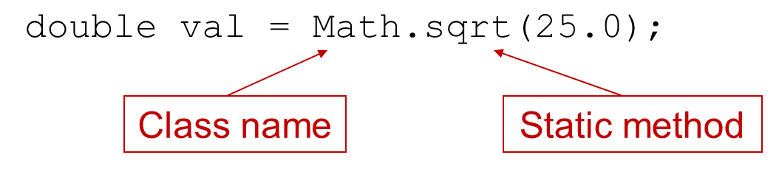
Static Class Members
Static fields and static methods do not belong to a single instance of a class.
To invoke a static method or use a static field, the class name, rather than the instance name, is used.
Example:

Slide 6
Static Fields (1 of 2)
Class fields are declared using the static keyword between the access specifier and the field type.
private static int instanceCount = 0;
The field is initialized to 0 only once, regardless of the number of times the class is instantiated.
Primitive static fields are initialized to 0 if no initialization is performed.
Examples: Countable.java, StaticDemo.java

Slide 7
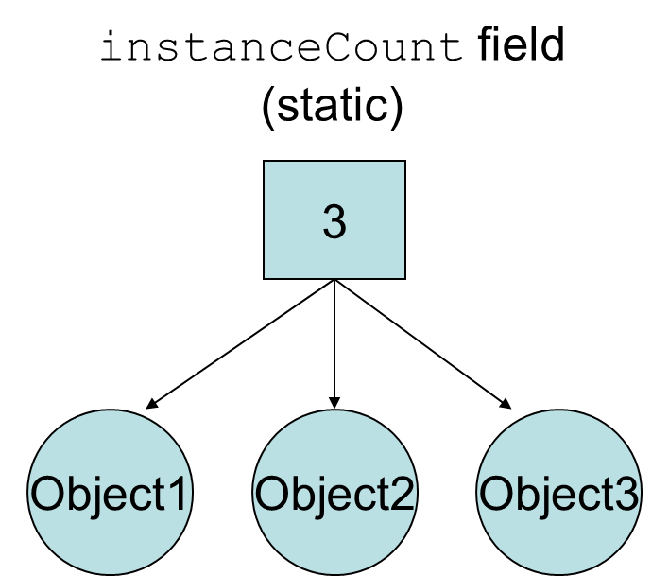
Static Fields (2 of 2)
Notes:
The program creates three instances of the Countable class, referenced by the variables object 1, object 2, and object 3.

Slide 8
Static Methods (1 of 2)
Methods can also be declared static by placing the static keyword between the access modifier and the return type of the method.
public static double milesToKilometers(double miles)
{…}
When a class contains a static method, it is not necessary to create an instance of the class in order to use the method.
double kilosPerMile = Metric.milesToKilometers(1.0);
Examples: Metric.java, MetricDemo.java

Slide 9
Static Methods (2 of 2)
Static methods are convenient because they may be called at the class level.
They are typically used to create utility classes, such as the Math class in the Java Standard Library.
Static methods may not communicate with instance fields, only static fields.

Slide 10
Passing Objects as Arguments (1 of 2)
Objects can be passed to methods as arguments.
Java passes all arguments by value.
When an object is passed as an argument, the value of the reference variable is passed.
The value of the reference variable is an address or reference to the object in memory.
A copy of the object is not passed, just a pointer to the object.
When a method receives a reference variable as an argument, it is possible for the method to modify the contents of the object referenced by the variable.

Slide 11
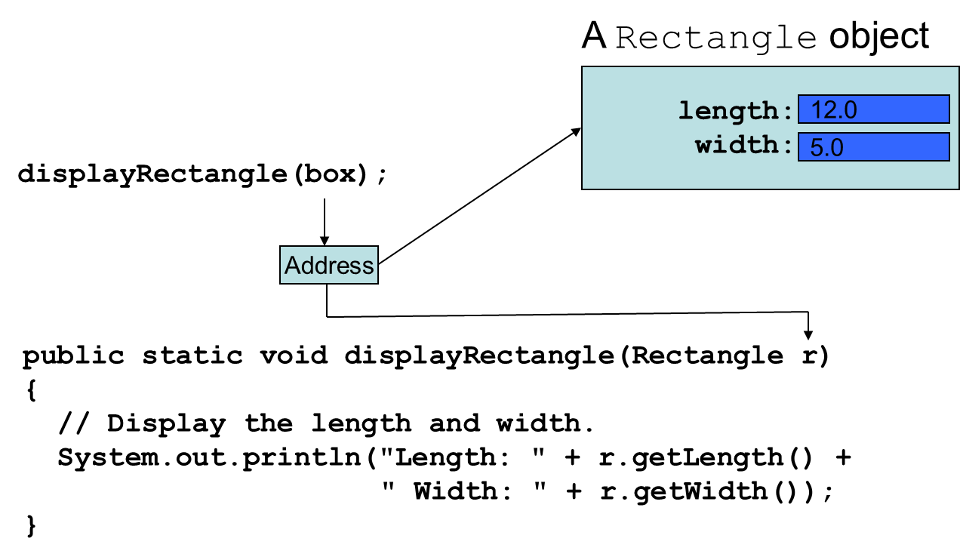
Passing Objects as Arguments (2 of 2)
Examples:
PassObject.java
PassObject2.java
Notes:
The computer code for passing objects as arguments displays six lines. The lines are as follows. Line 1. public static void display Rectangle left parenthesis Rectangle r right parenthesis. Line 2. Left brace. Line 3. Indent once. forward slash forward slash Display the length and width. Line 4. Indent once. system period out period print l n left parenthesis double quote Length colon double quote plus r period get Length left parenthesis right parenthesis plus. Line 5. Indent twice. double quote Width colon double quote plus r period get Width left parenthesis right parenthesis right parenthesis semicolon. Line 6. Right brace. The adress points to Rectangle left parenthesis box right parenthesis semicolon and r in the computer code points to address.

Slide 12
Returning Objects From Methods (1 of 2)
Methods are not limited to returning the primitive data types.
Methods can return references to objects as well.
Just as with passing arguments, a copy of the object is not returned, only its address.
See example: ReturnObject.java
Method return type:
public static BankAccount getAccount()
{
…
return new BankAccount(balance);
}

Slide 13
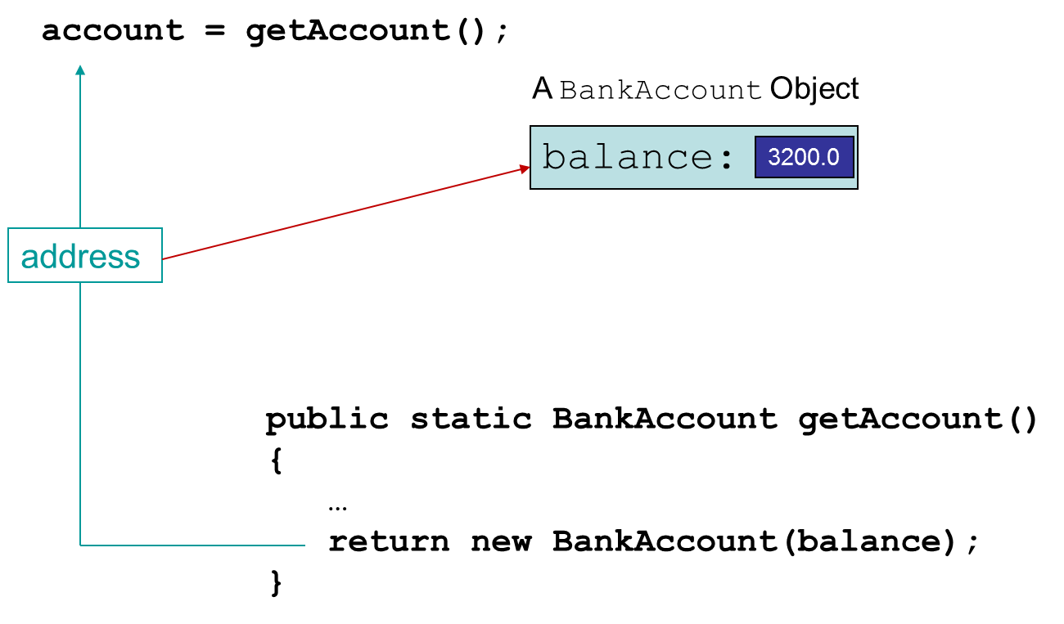
Returning Objects From Methods (2 of 2)
Notes:
The computer code for returning objects from method has four lines. Line 1. public static Bank Account get Account left parenthesis right parenthesis. Line 2. Left brace. Line 3. Indent once. period period period. Line 4. Indent once. return new Bank Account left parenthesis balance right parenthesis semicolon. Line 5. Right brace. Line 4 in the computer code points to address and address points to account = get Account left parenthesis right parenthesis semicolon.

Slide 14
The toString Method (1 of 3)
The toString method of a class can be called explicitly:
Stock xyzCompany = new Stock ("XYZ", 9.62);
System.out.println(xyzCompany.toString());
However, the toString method does not have to be called explicitly but is called implicitly whenever you pass an object of the class to println or print.
Stock xyzCompany = new Stock ("XYZ", 9.62);
System.out.println(xyzCompany);

Slide 15
The toString Method (2 of 3)
The toString method is also called implicitly whenever you concatenate an object of the class with a string.
Stock xyzCompany = new Stock ("XYZ", 9.62);
System.out.println("The stock data is:\n" + xyzCompany);

Slide 16
The toString Method (3 of 3)
All objects have a toString method that returns the class name and a hash of the memory address of the object.
We can override the default method with our own to print out more useful information.
Examples: Stock.java, StockDemo1.java

Slide 17
The equals Method (1 of 3)
When the == operator is used with reference variables, the memory address of the objects are compared.
The contents of the objects are not compared.
All objects have an equals method.
The default operation of the equals method is to compare memory addresses of the objects (just like the == operator).

Slide 18
The equals Method (2 of 3)
The Stock class has an equals method.
If we try the following:
Stock stock1 = new Stock("GMX", 55.3);
Stock stock2 = new Stock("GMX", 55.3);
if (stock1 == stock2) // This is a mistake.
System.out.println("The objects are the same.");
else
System.out.println("The objects are not the same.");
only the addresses of the objects are compared.

Slide 19
The equals Method (3 of 3)
Instead of using the == operator to compare two Stock objects, we should use the equals method.
public boolean equals(Stock object2)
{
boolean status;
if(symbol.equals(Object2.symbol && sharePrice == Object2.sharePrice)
status = true;
else
status = false;
return status;
}
Now, objects can be compared by their contents rather than by their memory addresses.
See example: StockCompare.java

Slide 20
Methods That Copy Objects
There are two ways to copy an object.
You cannot use the assignment operator to copy reference types
Reference only copy
This is simply copying the address of an object into another reference variable.
Deep copy (correct)
This involves creating a new instance of the class and copying the values from one object into the new object.
Example: ObjectCopy.java

Slide 21
Copy Constructors
A copy constructor accepts an existing object of the same class and clones it
public Stock(Stock object 2)
{
symbol = object2.symbol;
sharePrice = object2.sharePrice;
}
// Create a Stock object
Stock company1 = new Stock("XYZ", 9.62);
//Create company2, a copy of company1
Stock company2 = new Stock(company1);

Slide 22
Aggregation
Creating an instance of one class as a reference in another class is called object aggregation.
Aggregation creates a “has a” relationship between objects.
Examples:
Instructor.java, Textbook.java, Course.java, CourseDemo.java

Slide 23
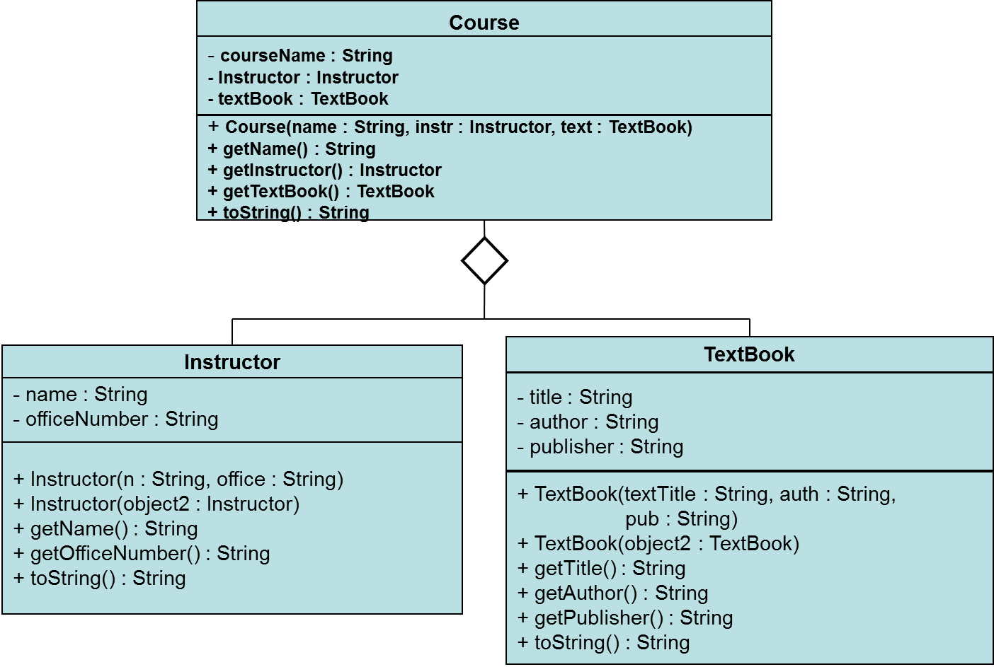
Aggregation in U M L Diagrams
Notes:
In the U M L diagram the superclass, course, is positioned at the top, and the subclasses, instructor and textbook, are positioned below and point to the superclass. The U M L diagram connects two classes with a line that has an open diamond at one end. The attributes and operations of each class in the system are as follows. Course. Dash course Name colon String, dash Instructor colon Instructor, dash textbook colon Textbook, plus course left parenthesis name colon String, i n s t r colon Instructor, text colon TextBook right parenthesis, plus get Name left parenthesis right parenthesis colon String, plus get Instructor left parenthesis right parenthesis colon instructor, plus get TextBook left parenthesis right parenthesis colon TextBook, plus to String left parenthesis right parenthesis colon string. Instructor. dash name colon string, plus instructor left parenthesis n colon string, office colon String right parenthesis, plus instructor left parenthesis object 2 colon instructor right parenthesis, plus get Name left parenthesis right parenthesis colon String, plus get Office Number left parenthesis right parenthesis colon string, plus to String left parenthesis right parenthesis colon String. TextBook. Dash title colon string, dash author colon string, dash publisher colon string, plus, Textbook left parenthesis text title colon string, a u t h colin string, p u b colon string right parenthesis, plus TextBook left parenthesis object 2 colon TextBook right parenthesis, plus get Title left parenthesis right parenthesis colon string, plus get Author left parenthesis right parenthesis colon string, plus to string left parenthesis right parenthesis colon string.

Slide 24
Returning References to Private Fields
Avoid returning references to private data elements.
Returning references to private variables will allow any object that receives the reference to modify the variable.

Slide 25
Null References
A null reference is a reference variable that points to nothing.
If a reference is null, then no operations can be performed on it.
References can be tested to see if they point to null prior to being used.
if(name != null)
{
System.out.println("Name is: " + name.toUpperCase());
}
Examples: FullName.java, NameTester.java

Slide 26
Method Chaining (1 of 4)
When working with aggregate objects, you sometimes need to work through several layers of objects to call a method.
Example: suppose you have a Course object named course, and you want to get the name of the course's instructor, converted to uppercase.
// Get the Instructor object.
Instructor instr = course.getInstructor();
// Get the instructor's name.
String name = instr.getName();
// Convert the name to uppercase.
String upperName = name.toUpperCase();

Slide 27
Method Chaining (2 of 4)
The previous code requires three statements, and declares three variables.
The code can be simplified with method chaining:
String upperName = course.getInstructor().getName().toUpperCase();

Slide 28
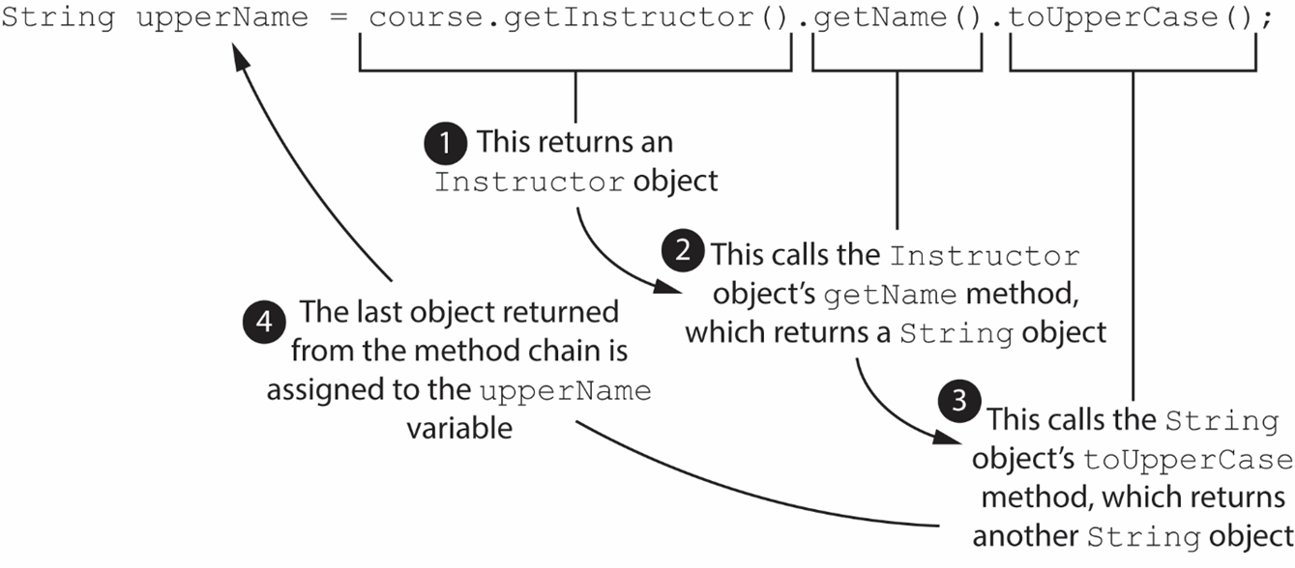
Method Chaining (3 of 4)
Notes:
The code is as follows. String upperName = course period get Instructor left parenthesis right parenthesis period get Name left parenthesis right parenthesis period to Upper Case left parenthesis right parenthesis semicolon. course period get Instructor left parenthesis right parenthesis is labeled, 1. This return an instructor object. get Name left parenthesis right parenthesis is labeled, 2. This calls the instructor objects get Name method, which returns a string object. to Upper Case left parenthesis right parenthesis is labeled, 3. This calls the string objects to Upper Case method, which returns another string object. String upper name is labeled, 4. The last object returned from the method chain is assigned to the upper Name variable. The arrows extend from 1 to 2, 2 to 3, and 3 to 4.

Slide 29
Method Chaining (4 of 4)
To improve readability, method chain statements are commonly written across multiple lines:
String upperName = course.getInstructor()
.getName()
.toUpperCase();

Slide 30
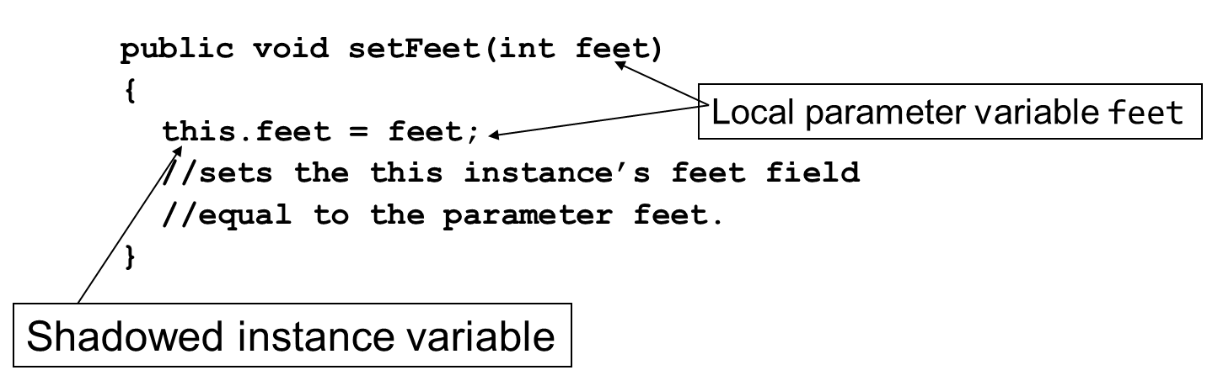
The this Reference (1 of 2)
The this reference is simply a name that an object can use to refer to itself.
The this reference can be used to overcome shadowing and allow a parameter to have the same name as an instance field.
Notes:
The lines are as follows. Line 1. public void set Feet left parenthesis i n t feet right parenthesis. Line 2. Left brace. Line 3. Indent once. this period feet = feet semicolon. Line 4. Indent once. Forward slash forward slash sets the this instance’s feet filed. Line 5. Indent once, Forward slash forward slash equal to the parameter feet. Line 6. Right brace. Feet in the line 1 and line 3 are together labeled, local parameter variable feet. This in line 3 is labeled, shadowed instance variable.

Slide 31
The this Reference (2 of 2)
The this reference can be used to call a constructor from another constructor.
public Stock(String sym)
{
this(sym, 0.0);
}
This constructor would allow an instance of the Stock class to be created using only the symbol name as a parameter.
It calls the constructor that takes the symbol and the price, using sym as the symbol argument and 0 as the price argument.
Elaborate constructor chaining can be created using this technique.
If this is used in a constructor, it must be the first statement in the constructor.

Slide 32
Mutable and Immutable Classes (1 of 3)
You have seen examples of classes that have mutators or other methods that change the contents of the class's fields.
A class that allows its fields to be changed is known as a mutable class.
A mutable object is an instance of a mutable class.

Slide 33
Mutable and Immutable Classes (2 of 3)
An immutable class is a class that does not allow its fields to be changed once they are initialized with values.
An immutable object is an instance of an immutable class.
The internal state of an immutable object cannot be changed once the object is created.

Slide 34
Mutable and Immutable Classes (3 of 3)
These are some of the benefits to using immutable classes and objects:
Immutable classes are simple to design and easy to understand.
Because the internal state of an immutable object never changes, it is easier to debug the code that uses the object.
You do not have to make defensive copies of immutable objects.
Immutable objects are safe to use in a multithreaded program.

Slide 35
Guidelines for Creating Immutable Classes
The class should be declared final in the class header.
All the class's field variables should be declared private and final.
The class should have a constructor that initializes all the class's fields.
The class cannot have mutators, or any methods that change the class's internal state.
If the class has a field that is a mutable object, the class should not have an accessor or other method that returns a reference to that field. Instead, the method should make a deep copy of the mutable field and return a reference to the copy. Any changes that are made to the copy will not affect the original object.
If the constructor accepts a reference to a mutable object, that reference should not be stored in a field. Instead, the constructor should make a deep copy of the mutable object and store a reference to the copy.
Examples: Contact.java and GetContactInfo.java

Slide 36
Immutable Classes with Mutable Objects as Fields (1 of 3)
A final reference variable cannot point to any object other than the one it is initialized with.
An error will occur if you try to reassign a final reference variable to a different object.
Although a final reference variable cannot be changed, the contents of the object that the variable refers to can be changed, if that object is mutable.
Example:
final CellPhone mycell = new CellPhone("Motorola", "M1", 799.99);
mycell.setModel("M75");
mycell.setRetailPrice(899.99);
In this code, even though mycell is declared as final, it can still be used to change the contents of the object it refers to.

Slide 37
Immutable Classes with Mutable Objects as Fields (2 of 3)
If your immutable class contains a field that refers to a mutable object, be sure not to write methods in the immutable class that return a reference to the mutable object.
Doing so makes it possible for code outside the class to change the state of the mutable object.
If you need to provide an accessor for the mutable object, make sure it returns a reference to a copy of the mutable object instead of the original.

Slide 38
Immutable Classes with Mutable Objects as Fields (3 of 3)
If your immutable class's constructor accepts a reference to a mutable object as an argument, do not assign that reference to a field.
If another reference to the same object happens to exist outside the class, it's possible for code outside the class to change the state of the mutable object.
Instead, make a copy of the mutable object and assign the field a reference to the copy.
Examples: City.java, Country.java, CountryData.java

Slide 39
Enumerated Types (1 of 2)
Known as an enum, requires declaration and definition like a class
Syntax:
enum typeName { one or more enum constants }
Definition:
enum Day { SUNDAY, MONDAY, TUESDAY, WEDNESDAY, THURSDAY, FRIDAY, SATURDAY }
Declaration:
Day WorkDay; // creates a Day enum
Assignment:
Day WorkDay = Day.WEDNESDAY;

Slide 40
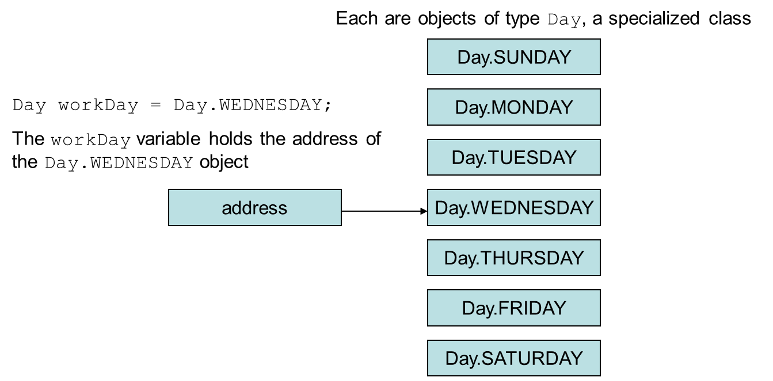
Enumerated Types (2 of 2)
An enum is a specialized class
Notes:
The diagram has seven rectangular objects. The objects displays the identifier’s. Each are objects of type Day, a specialized class. The identifiers are as follows. Day. SUNDAY, Day. MONDAY, Day. TUESDAY, Day. WEDNESDAY, Day. THURSDAY, Day. FRIDAY, and Day. SATURDAY. The address points to Day. WEDNESDAY class and is labeled, Day workday = Day period Wednesday semicolon. The workday variable holds the address of the Day, WEDNESDAY object.

Slide 41
Enumerated Types - Methods
toString – returns name of calling constant
ordinal – returns the zero-based position of the constant in the enum. For example the ordinal for Day.THURSDAY is 4
equals – accepts an object as an argument and returns true if the argument is equal to the calling enum constant
compareTo – accepts an object as an argument and returns a negative integer if the calling constant’s ordinal < than the argument’s ordinal, a positive integer if the calling constant’s ordinal > than the argument’s ordinal and zero if the calling constant’s ordinal == the argument’s ordinal.
Examples: EnumDemo.java, CarType.java, SportsCar.java, SportsCarDemo.java

Slide 42
Enumerated Types - Switching
Java allows you to test an enum constant with a switch statement.
Example: SportsCarDemo2.java

Slide 43
Garbage Collection (1 of 6)
When objects are no longer needed they should be destroyed.
This frees up the memory that they consumed.
Java handles all of the memory operations for you.
Simply set the reference to null and Java will reclaim the memory.

Slide 44
Garbage Collection (2 of 6)
The Java Virtual Machine has a process that runs in the background that reclaims memory from released objects.
The garbage collector will reclaim memory from any object that no longer has a valid reference pointing to it.
BankAccount account1 = new BankAccount(500.0);
BankAccount account2 = account1;
This sets account1 and account2 to point to the same object.

Slide 45
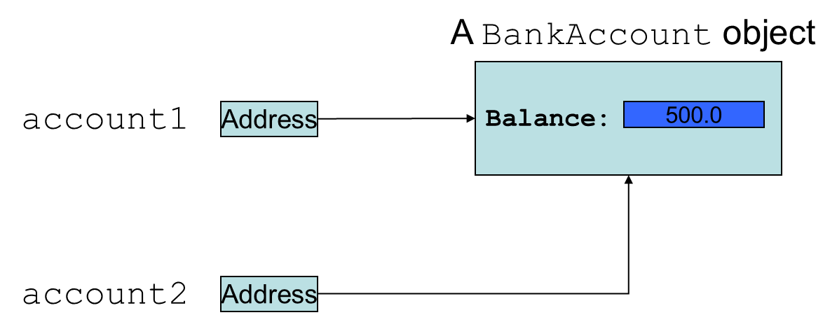
Garbage Collection (3 of 6)
Here, both account1 and account2 point to the same
instance of the BankAccount class.

Slide 46

Garbage Collection (4 of 6)
However, by running the statement: account1 = null;
only account2 will be pointing to the object.

Slide 47
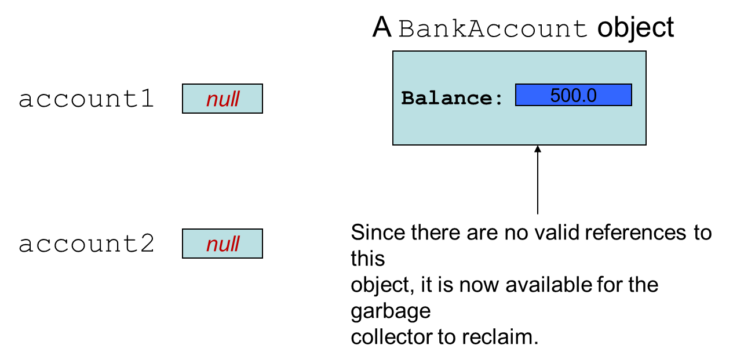
Garbage Collection (5 of 6)
If we now run the statement: account2 = null;
neither account1 or account2 will be pointing to the object.
Notes:
The object is labeled, since there is no valid references to this object, it is now available for the garbage collector to reclaim.

Slide 48
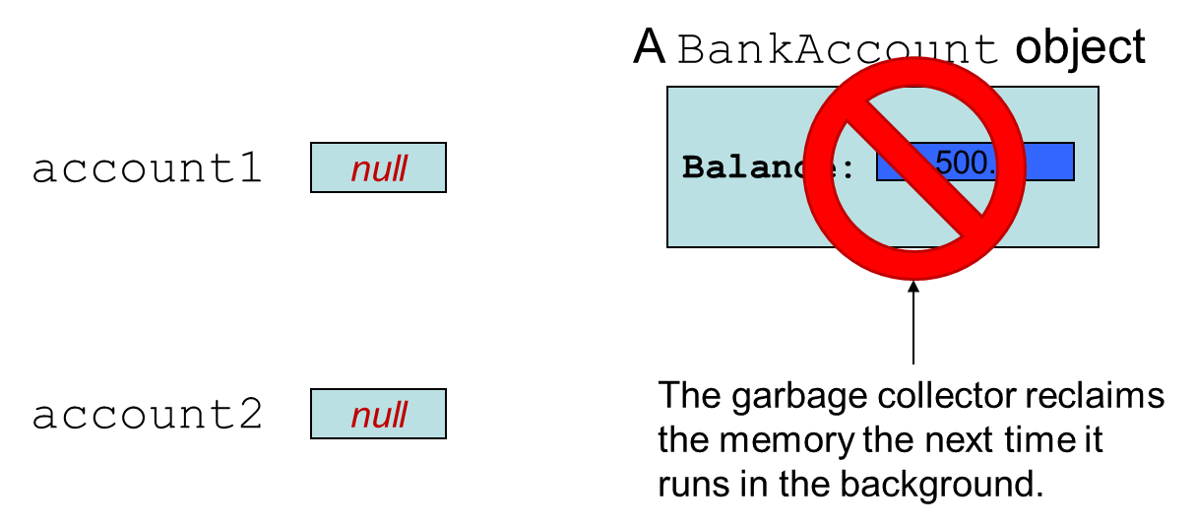
Garbage Collection (6 of 6)
Notes:
The object with circle backslash symbol is labeled, the garbage collector reclaims the memory to the next time it runs in the background.

Slide 49
The finalize Method
If a method with the signature:
public void finalize(){…}
is included in a class, it will run just prior to the garbage collector reclaiming its memory.
The garbage collector is a background thread that runs periodically.
It cannot be determined when the finalize method will actually be run.

Slide 50
Class Collaboration
Collaboration – two classes interact with each other
If an object is to collaborate with another object, it must know something about the second object’s methods and how to call them
If we design a class StockPurchase that collaborates with the Stock class (previously defined), we define it to create and manipulate a Stock object
See examples: StockPurchase.java, StockTrader.java

Slide 51
C R C Cards
Class, Responsibilities and Collaborations (C R C) cards are useful for determining and documenting a class’s responsibilities
The things a class is responsible for knowing
The actions a class is responsible for doing
C R C Card Layout (Example for class Stock)
Stock
Know stock to purchase | Stock class
Know number of shares | None
Calculate cost of purchase | Stock class
Etc. | None or class name

Slide 52

Copyright
This work is protected by United States copyright laws and is provided solely for the use of instructors in teaching their courses and assessing student learning. Dissemination or sale of any part of this work (including on the World Wide Web) will destroy the integrity of the work and is not permitted. The work and materials from it should never be made available to students except by instructors using the accompanying text in their classes. All recipients of this work are expected to abide by these restrictions and to honor the intended pedagogical purposes and the needs of other instructors who rely on these materials.

